Slide 1
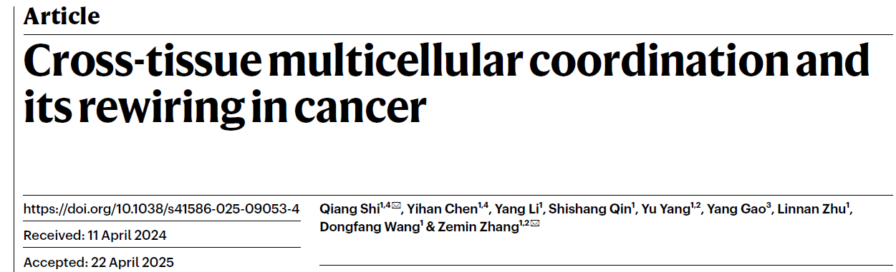
JC 6/13/2025
Wendao

Slide 2
Background
Tissue function depends on coordination among diverse cell types, but how this coordination is organized across tissues remains poorly understood.
Single-cell transcriptomics has uncovered many cell types, yet systematic analysis of multicellular organization across tissues is still lacking.
Prior studies have focused on cell–cell interactions using ligand–receptor pairs, but these do not fully capture higher-order multicellular structures.
A better understanding of cross-tissue multicellular ecosystems is crucial for uncovering principles of tissue homeostasis, aging, and disease, such as cancer.

Slide 3
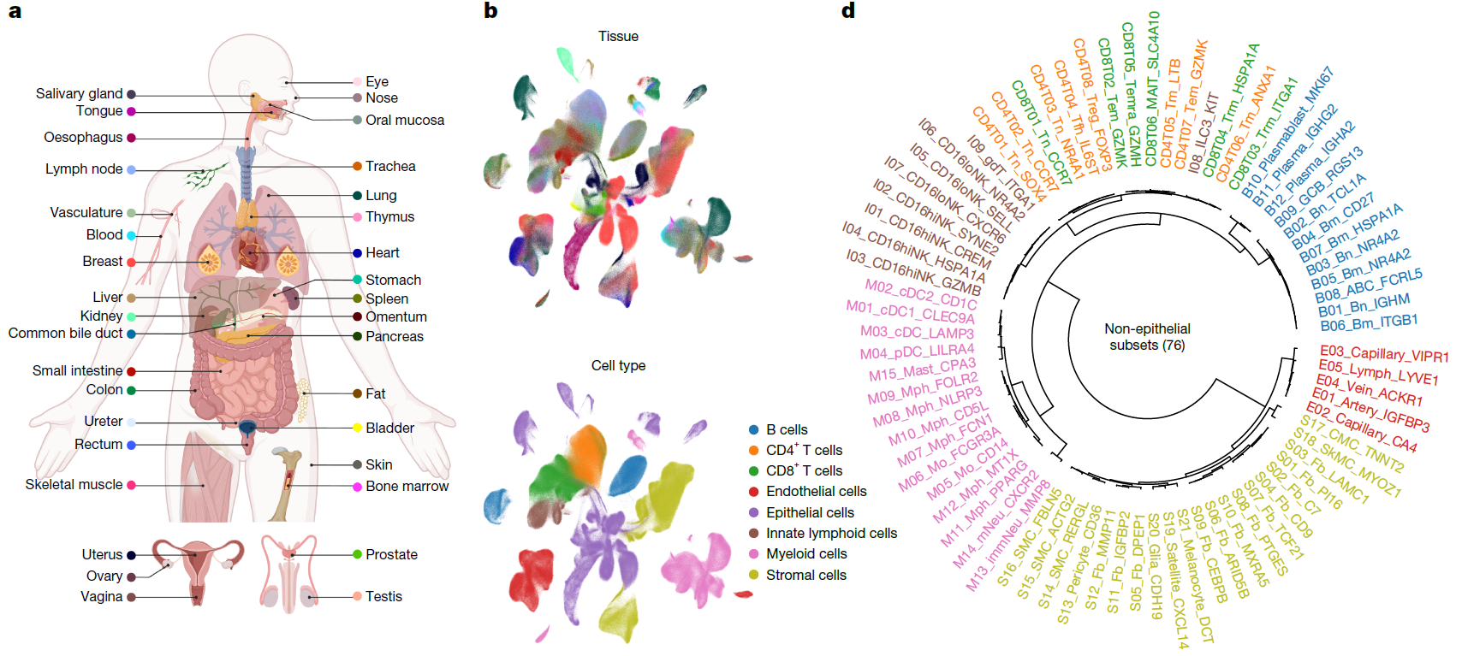
Pan-tissue single-cell atlas
2.3 million cells, 706 samples, 35 human tissues

Slide 4
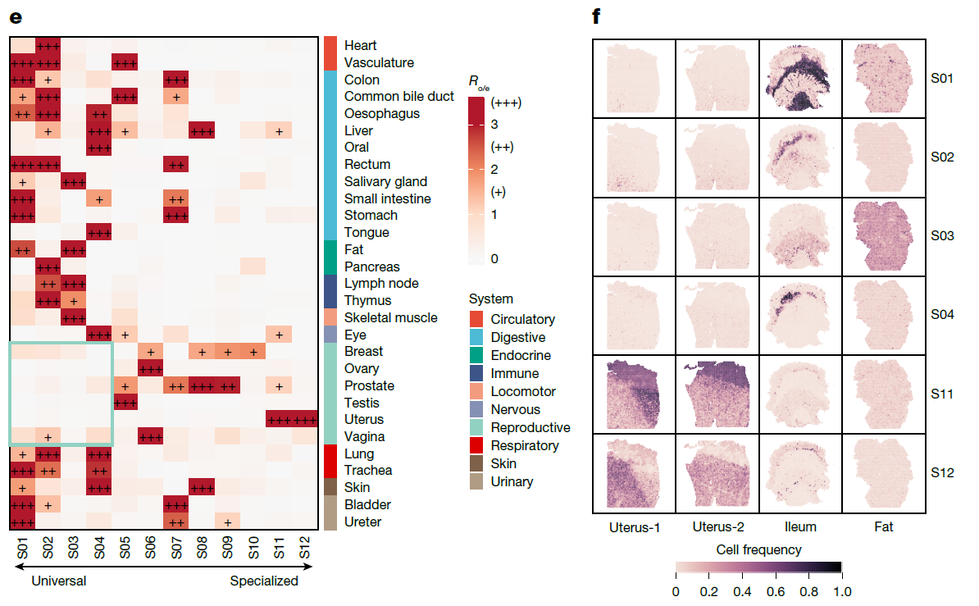
Fibroblast diversity across tissues
Fibroblast clusters are universal or specialized across tissues
Fibroblast clusters in reproductive tissues are more specialized

Slide 5
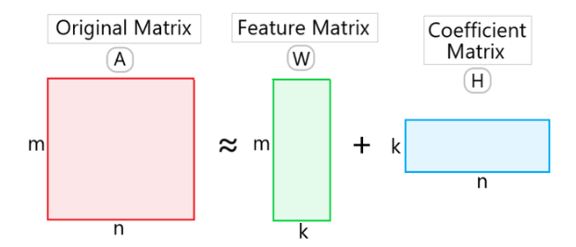
Non-negative factorization (NMF)
Decompose large matrix into two smaller meaningful matrices
Inherent clustering property
Used in many single-cell studies to find gene modules
m: cells,
n: genes,
k: gene modules

Slide 6
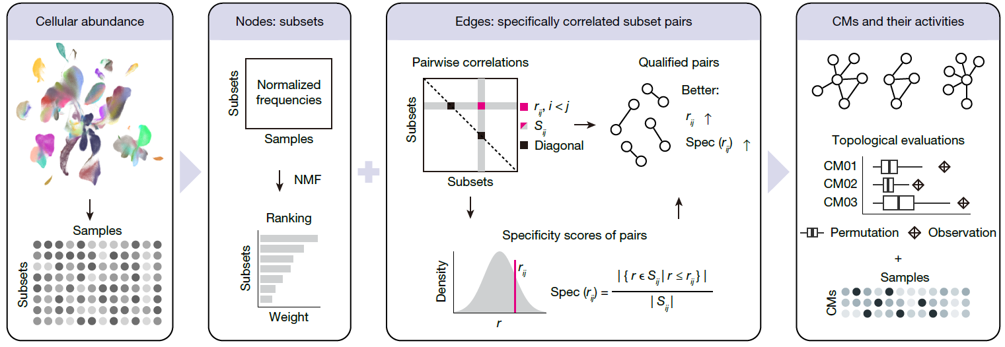
CoVarNet for identifying cell modules
NMF to find cell modules using cell-tissue frequency matrix (not gene expression matrix)
Pearson correlation with specificity cutoff to find specifically correlated subset pairs
m: samples,
n: cell clusters,
k: cell modules
Subset: different cell cluster

Slide 7
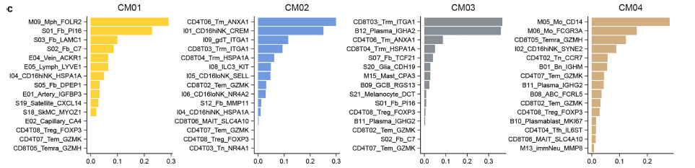
Cell module examples

Slide 8
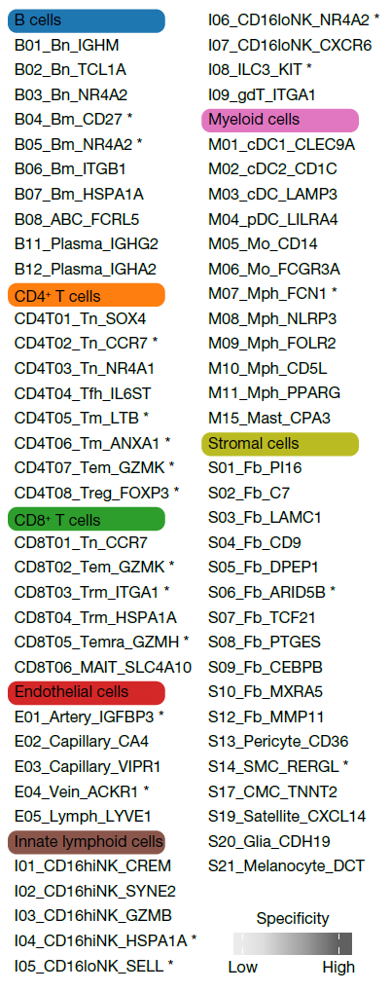
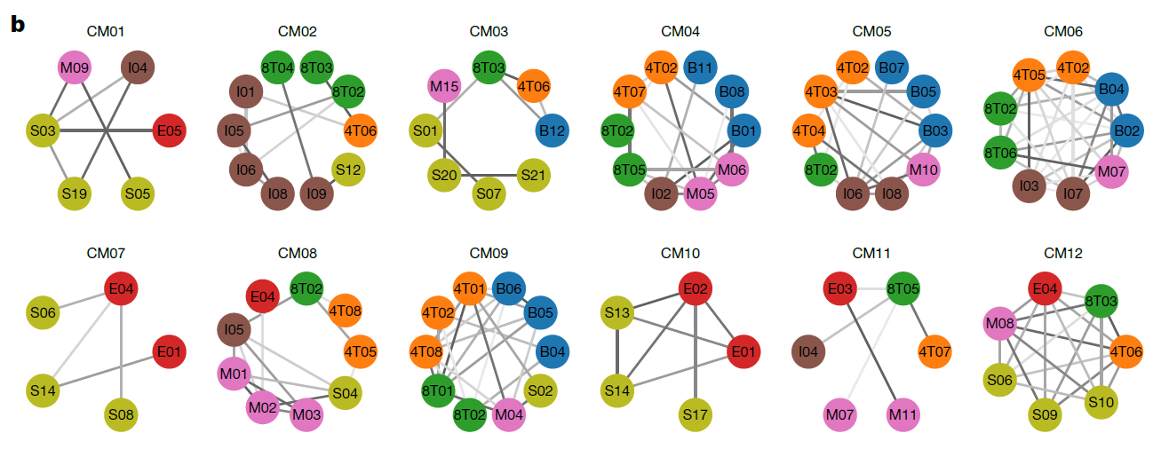
Cell modules
Cell module graphs using cells as nodes and specificity scores as edges

Slide 9
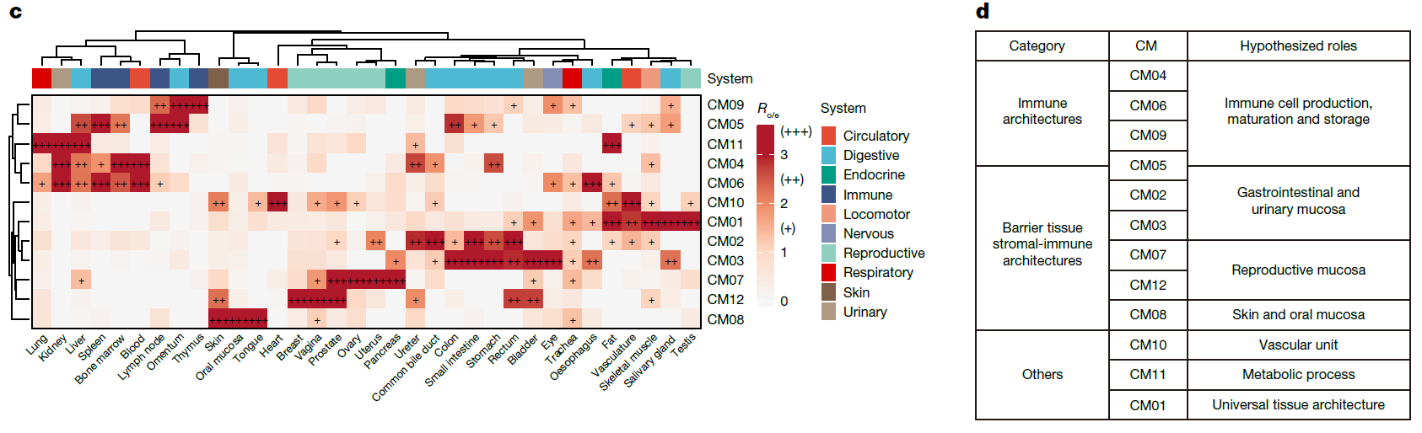
Tissue specificity and functions of cell modules
CMs exhibit distinct preferences for multiple tissues, representing cross-tissue multicellular ecosystems

Slide 10
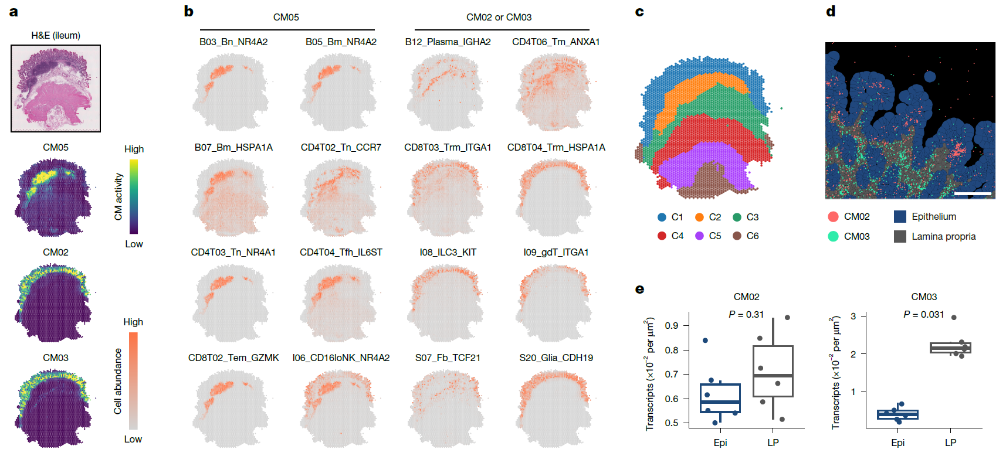
Spatial characteristics of cell modules in intestine
CM05: Peyer’s patch (small masses of lymphatic tissue)
CM02 and CM03: Lamina propria (loose connective tissue)

Slide 11
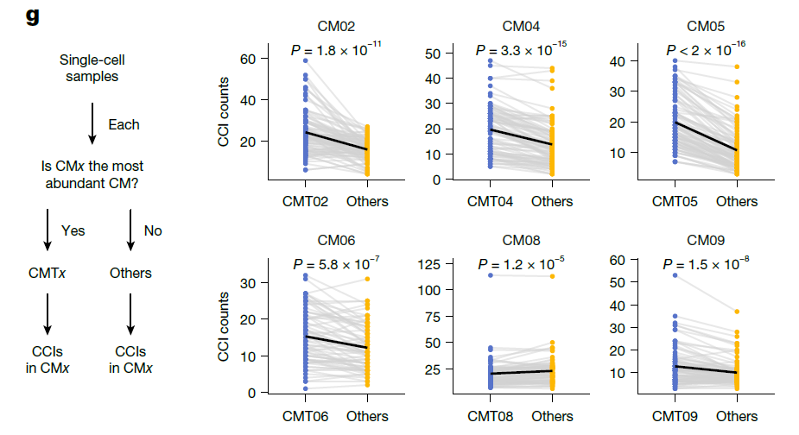
Cell-cell communication in cell modules
CellphoneDB prediction
Higher CM cell–cell interactions in samples enriched with CMs
My comment: the more significant interactions may be due to more cells, purely a statistic trick but not biological difference

Slide 12
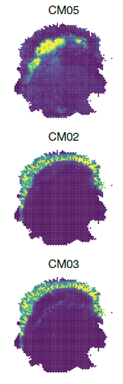
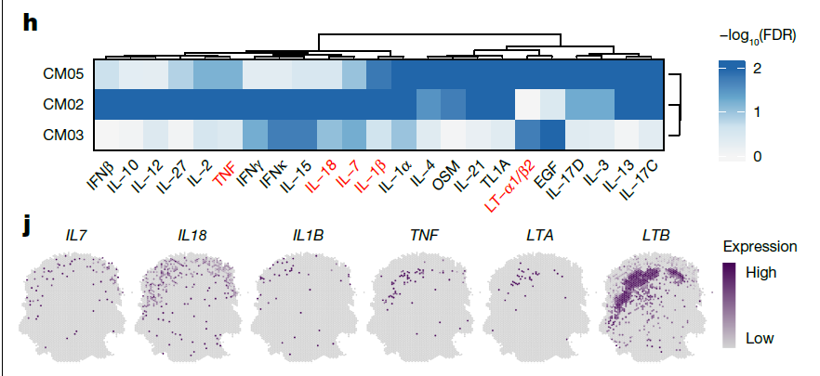
Cytokine expression and response in cell modules
Cytokine spatial enrichment: IL7 and IL18 in CM02/CM03 (C1) niche, LTA and LTB in CM05 (C2) niche
cytokine-mediated regulatory landscape within CMs
My comment: cytokine response and expression does not match well (e.g. TNF, LTB)
Predicted
response
Expression

Slide 13
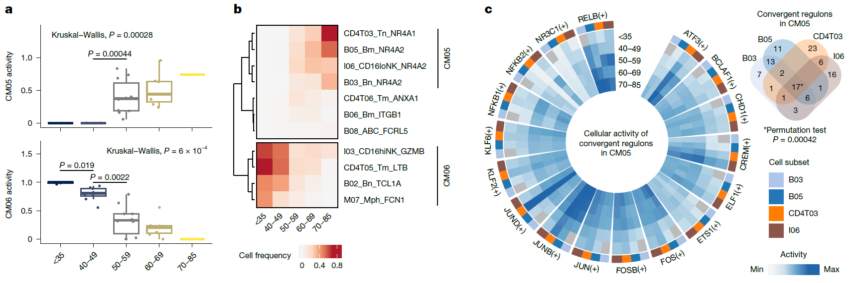
Ageing associated cell modules
In spleen, CM05 increased by age and CM06 decreased
Increased activity of some regulons in CM05 by SCENIC
Jun and Fos: immune ageing

Slide 14
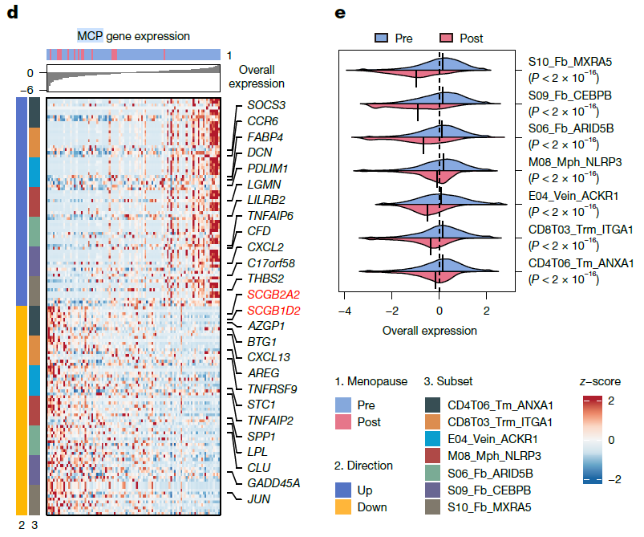
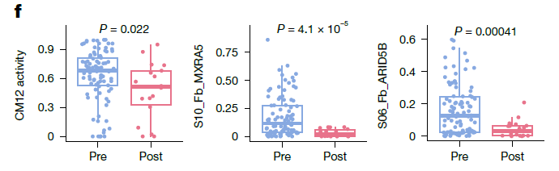
Cell modules in menopausal trajectory
A CM12-related multiple cellular program (gene module) upregulated in pre-menopausal
SCGB2A2: breast cancer marker

Slide 15
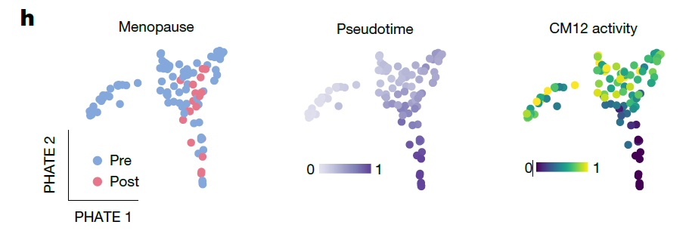
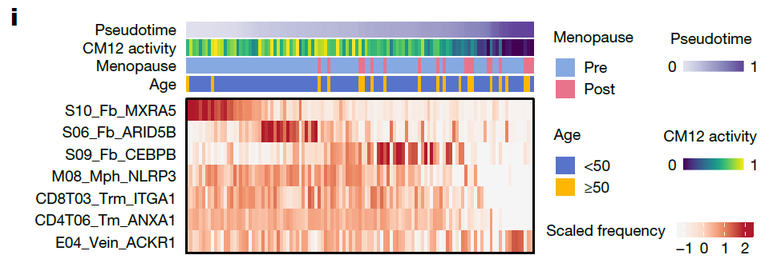
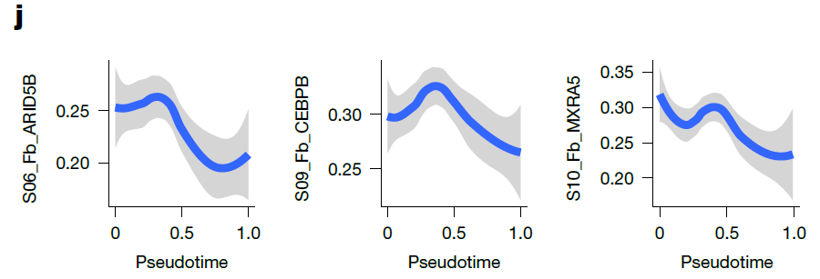
Cell modules in menopausal trajectory
Menopausal trajectory from pre-menopausal to post-menopausal states
Decreasing fibroblast clusters (S10, S06, S09)
Decreasing inflammatory scores
Inflammatory scores

Slide 16
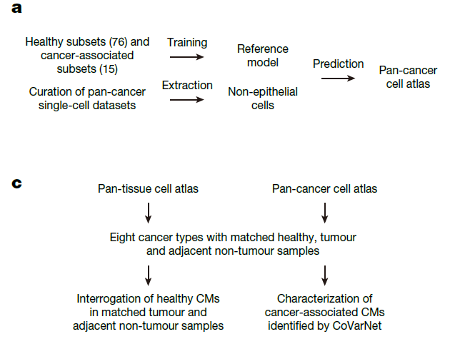
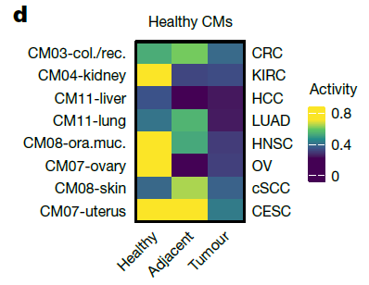
Identifying cell modules in cancer
Compare cell modules in healthy, tumor adjacent and tumor samples
Some cell modules in healthy tissues are decreased in cancers

Slide 17
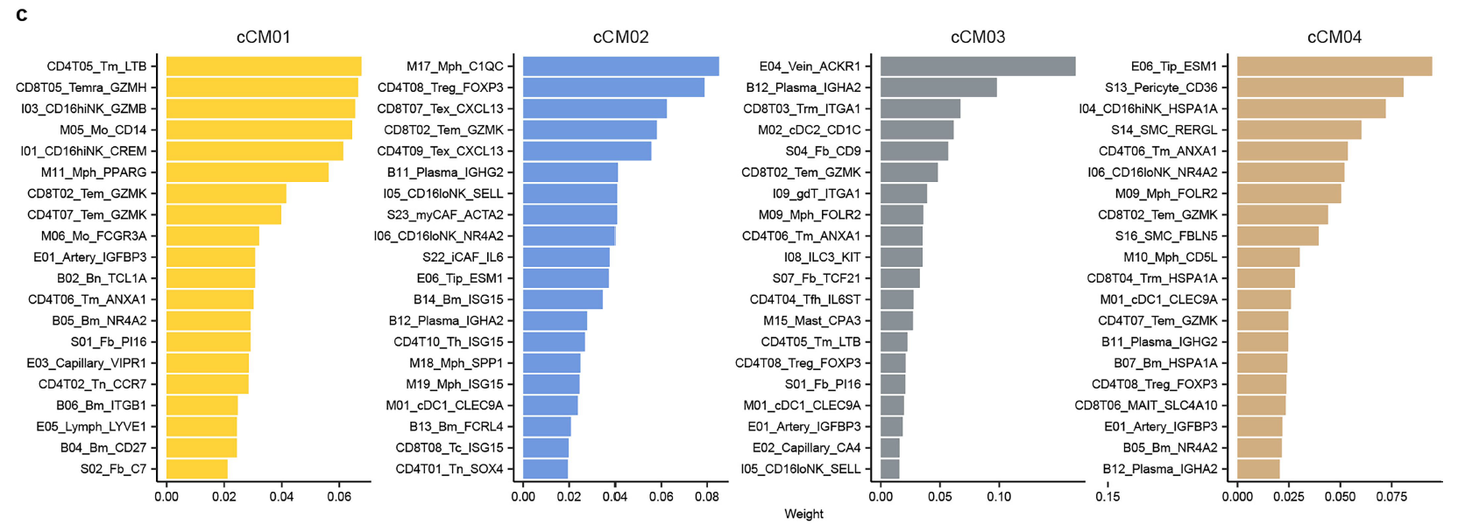
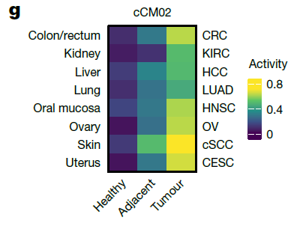
Cancer-associated cell modules
Four cancer-associated cell modules (cCMs) were identifying in eight cancer types
cCM02 composed primarily of cancer-associated cell subsets, was enriched in most cancer types

Slide 18
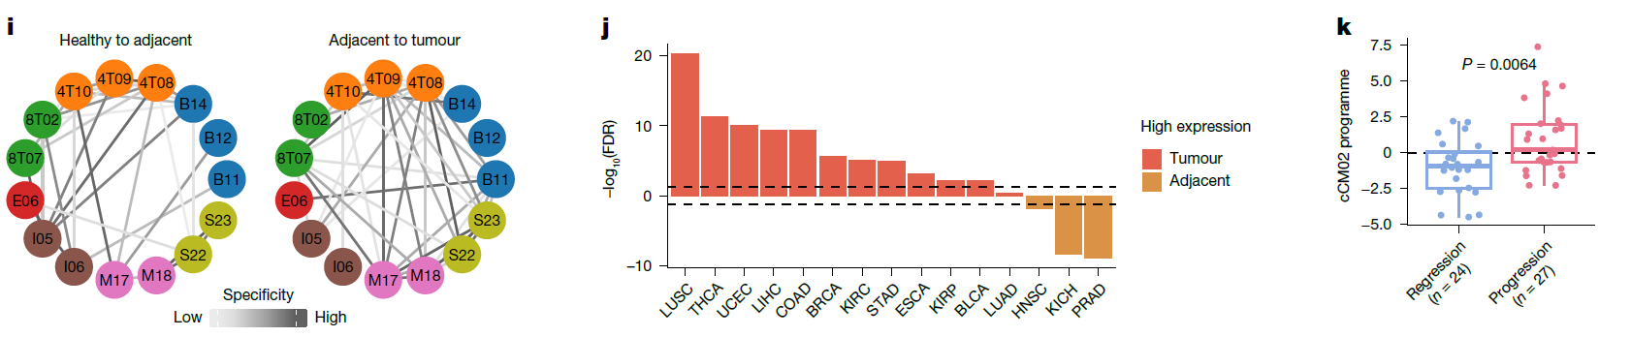
cCM02 in different conditions
Increased co-occurrence of cell subsets within cCM02 in tumor samples
Validation in independent data suggesting potential for early diagnosis: 1. TCGA 2. pre-invasive lung lesions

Slide 19
Summary
Created a human single-cell atlas of ~2.3 million cells across 35 tissues, revealing 12 conserved cross-tissue cellular modules (CMs) based on co-occurring cell types.
CMs represent coordinated multicellular ecosystems involved in immunity, metabolism, vasculature, and reproductive function, validated using spatial transcriptomics and cell–cell communication analysis.
Ageing and menopause were linked to dynamic shifts in CM activity—e.g., immune module changes in the spleen with age and fibroblast-related shifts in the breast post-menopause.
In cancer, normal tissue CMs are disrupted, while a convergent cancer-associated CM emerges across tumor types, marked by shared immune and stromal features.
Findings offer a framework for understanding tissue organization and disease progression, with potential applications in diagnostics and cancer treatment.

Slide 20
Limitation
Unlike using NMF for gene module analysis, CoVarNet only applies to altas-level dataset with many samples from diverse conditions (organ/tissue/disease)
The single-cell atlas may have uneven sampling across tissues, age groups, sexes
Cell cluster resolution (more small clusters or fewer large clusters) influences CM module results
CoVarNet mainly uses on co-occurrence of cell clusters to infer cell modules, but functional coordination (e.g. pathways with many involved cell types) are not considered.

